Slide 1
OLS Regression

Slide 2
OLS:- Ordinary least squares (OLS) or linear least squares is a method for estimating the unknown parameters in a linear regression model, with the goal of minimizing the differences between the observed responses in some arbitrary dataset and the responses predicted by the linear approximation of the data.
This is applied in both simple linear and multiple regression.

Slide 3
Infinite number of lines can be plotted through the scatter diagram between 2 variables.
Calculate the error terms of each line
Errors can be positive or negative, therefore sum of squared errors.
The line of best fit is one which has minimum sum of squared errors
Error is calculated as deviation of point from line as parallel to Y axis

Slide 4
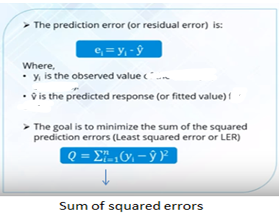
Sum of squared error
Error term

Slide 5
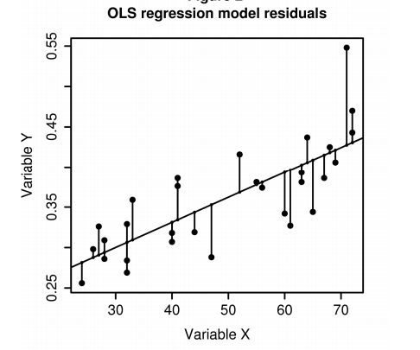
error

Slide 6
In linear regression we try to minimize the sum of squared errors.
The best regression line is one which has minimum sum of squared errors.

Slide 7
Assumptions Of OLS
It is important to know the underlying assumptions of OLS regression. This is because a lack of knowledge of OLS assumptions would result in its misuse and give incorrect results for the econometrics test completed. The importance of OLS assumptions cannot be overemphasized.

Slide 8
OLS Assumptions 1: Linear in Parameters
When the dependent variable (Y) is a linear function of independent variables (X's) and the error term, the regression is linear in parameters and not necessarily linear in X's.
In simpler terms we can say that the parameters that is intercept and slope (B0 and B1) needs to linear.

Slide 9
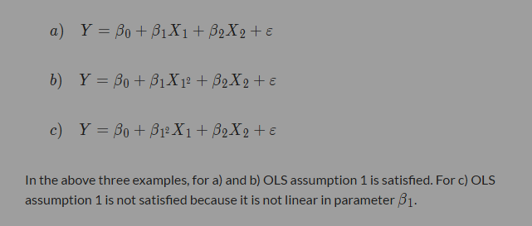
Assumption 1

Slide 10
OLS Assumption 2: There is a random sampling of observations
This assumption of OLS regression says that:
The sample taken for the linear regression model must be drawn randomly from the population. For example, if you have to run a regression model to study the factors that impact the scores of students in the final exam, then you must select students randomly from the university during your data collection process, rather than adopting a convenient sampling procedure.
The number of observations taken in the sample for making the linear regression model should be greater than the number of parameters to be estimated.
The X's should be fixed (i.e. independent variables should impact dependent variables). It should not be the case that dependent variables impact independent variables

Slide 11

OLS Assumption 3: conditional mean should be zero.
The expected value of the mean of the error terms of OLS regression should be zero given the values of independent variables.
In other words, the distribution of error terms has zero mean and doesn’t depend on the independent variables X's. Thus, there must be no relationship between the X's and the error term.

Slide 12
OLS Assumption 4: Sample Variation
Sample variation: The sample observations should not be of same type they should have some variation. We cant take one observation and multiply it will 100 and say we have 100 observations, this should not be done.

Slide 13
Assumption 5: There should be homoscedasticity and no autocorrelation.
The error terms all have the same variance and are not correlated with each other. In statistical jargon, the error terms are independent and identically distributed . This assumption means the error terms associated with different observations are not related to each other
This OLS assumption of no autocorrelation says that the error terms of different observations should not be correlated with each other.
Notes:
With respect to error terms
Variance is constant
Magnitude of errors is constant
As x increases , the magnitude of errors remains fixed

Slide 14

According to this OLS assumption, the error terms in the regression should all have the same variance.
If this variance is not constant (i.e. dependent on X’s), then the linear regression model has heteroscedastic errors and likely to give incorrect estimates.

Slide 15
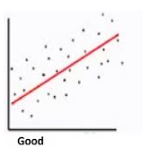
Homoscedasticity

Slide 16
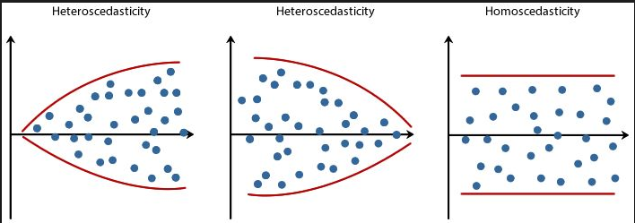

Slide 17
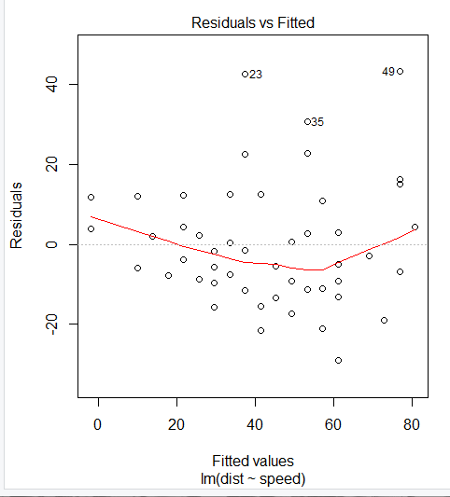
If the residuals are scattered with no pattern and you see a line (red) more or less straight, you can say that there is homoscedasticity in the error terms/residuals
A fitted value is simply another name for a predicted value

Slide 18
No Autocorrelation
This OLS assumption of no autocorrelation says that the error terms of different observations should not be correlated with each other.
In simple terms, this OLS assumption means that the error terms should be IID (Independent and Identically Distributed).
In linear regression the error terms needs to be independent.
If violation happens we need to detect and correct them.

Slide 19
There should exist no correlation between the series and its past values.
There should not exist correlation between pairs of error terms at a certain lag.
Lag 1: autocorrelation: between et and et-1
Lag 2: autocorrelation : between et and et-2

Slide 20
Usually in time series analysis we find the autocorrelation of error terms.
Error terms
Error terms
Uncorrelated error terms
correlated error terms

Slide 21
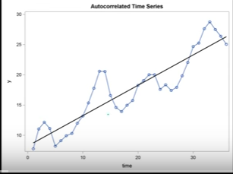

Slide 22

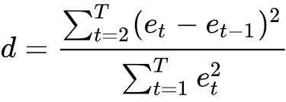
How to check for auto correlation
In statistics, the Durbin–Watson statistic is a test statistic used to detect the presence of autocorrelation in error terms.
The null and alternative hypotheses of the Durbin-Watson test are:
H0: The errors are uncorrelated
H1: The errors are correlated
And the test statistic D is:

Slide 23
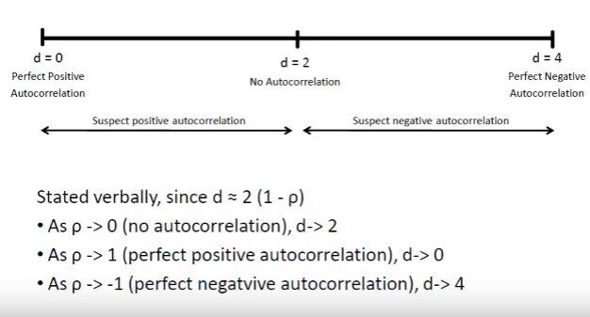
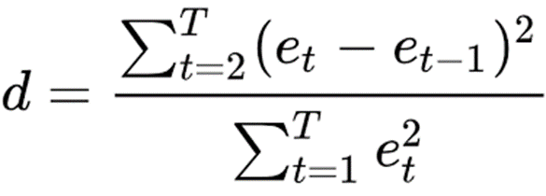

Slide 24
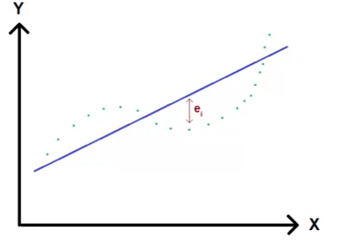
Positive Autocorrelation
Error terms instead of randomly distributed are positive if previous term is positive and negative error if previous error term is negative.

Slide 25
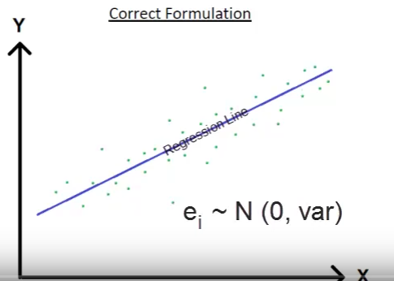
No autocorrelation

Slide 26
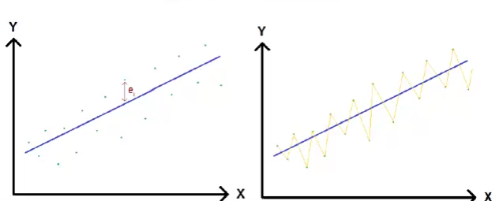
Negative Autocorrelation
Sequence of positive and negative error terms.

Slide 27
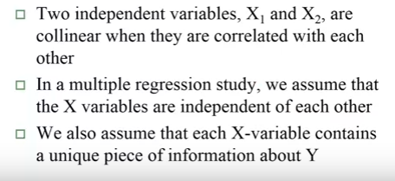
Assumption 6: There is no multi-collinearity

Slide 28
In statistics, multicollinearity (also collinearity) is a phenomenon in which one predictor variable in a multiple regression model can be linearly predicted from the others with a substantial degree of accuracy.

Slide 29
For example, suppose you spend your 24 hours in a day on three things – sleeping, studying, or playing. Now, if you run a regression with dependent variable as exam score/performance and independent variables as time spent sleeping, time spent studying, and time spent playing, then this assumption will not hold.
This is because there is perfect collinearity between the three independent variables.
Time spent sleeping = 24 – Time spent studying – Time spent playing.
In such a situation, it is better to drop one of the three independent variables from the linear regression model. If the relationship (correlation) between independent variables is strong (but not exactly perfect), it still causes problems in OLS estimators. Hence, this OLS assumption says that you should select independent variables that are not correlated with each other.

Slide 30
Hence, there should not be any inter correlation between the independent variables like x1, x2, x3 etc…
If there is moderate to high inter correlation among the independent variables it gives rise to problem of multi collinearity.

Slide 31
What are the problems of inter collinearity
If two independent variables contain essentially same information to a large extend, one gains little by using both in the regression model.
Multicollinearity leads to unstable estimates, it tends to increase the variance of regression coefficients.

Slide 32
How to assess presence of multicollinearity
One way is to obtain variance inflation factor (VIF).
VIF>10 indicates presence of multicollinearity ity.

Slide 33
What is the solution
One way is to keep only one of the two independent variables that are highly correlated in regression model.

Slide 34
THANK YOU

